Slide 1

Intro to
Programming
With python
Recursion:
part 1
Monday, April 21 2025 TOH210
Notes:
Layout objects pulled from: https://slidesgo.com/
All icons are from: https://thenounproject.com/

Slide 2

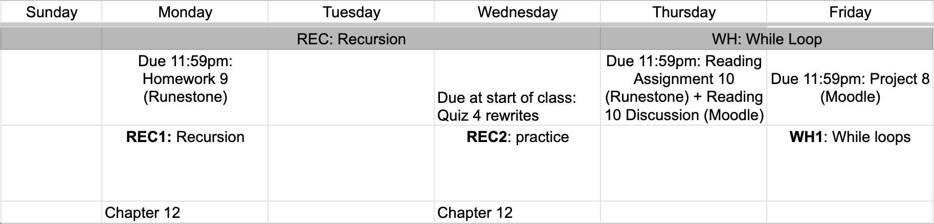
this week
google sheet link
Notes:
https://docs.google.com/forms/d/e/1FAIpQLSe3OloPAJSid4n6cyU_4qXpRWU7FOSmP7IVdRS_vh9cvYd9zQ/viewform?usp=sharing

Slide 3

recursion 1
colab workbook
click for access
found on Moodle under this week

Slide 4
Takeaways from last time
creating, manipulating, editing, outputting dictionary items
creating functions to do things
remember, solutions for the worksheet are up on Moodle

Slide 5


WARMUP
look ma, no code!
Suppose you wanted to write a program that would read from a file, and find the most frequent character in the file.
Without writing any actual code, work with a partner to write the sequence of steps this program would go through.

Slide 6
As we write more complicated programs, it becomes more and more important to think about how we’re organizing our code
One approach to this is procedural programming where your program is organized with functions
Here, the idea is to break your program into individual tasks, and write a function for each task.
If you have a really large task, you may want to consider having a function that calls other functions to complete smaller tasks.
we’ve seen this with the second question from
Monday’s worksheet, and from Project 7

Slide 7
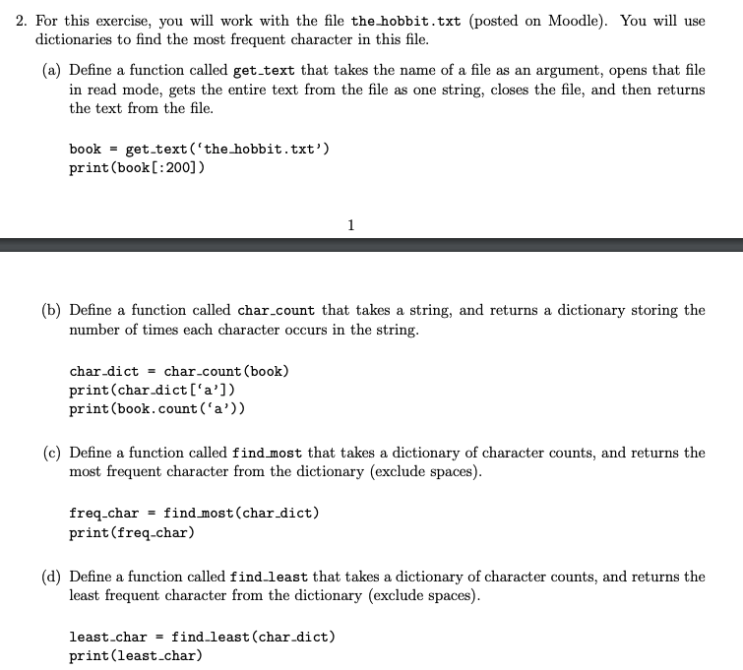

Slide 8
This is an example of where we could use procedural programming.
Let’s create a function most_frequent that takes in a file name and returns the most frequent character (beyond a space).
def most_frequent(filename:str)->str:
"""takes a file name, and returns the most
frequent character from the dictionary """
book = get_text(filename)
char_dict = char_count(book)
most_freq = find_most(char_dict)
return most_freq
Notice, we’re calling the functions we’ve already created. These functions are doing the subtasks, and most_frequent is just organizing them all together

Slide 9
So how do we actually use procedural programming effectively?
Take notes in your colab workbook
1. break your problem into easily definable tasks
3. create function headers with type annotations and docstring
How do you know if your task is the right size for a function?
2. create a function to do a single task
4. add to function body, one function at a time, making sure to test before moving on to the next function
Most functions are <10 lines, likely 2-4

Slide 10
It can be very helpful to actually map this out
you can format the docstring in the following way:
most_frequent
args: file_name (str), name of a text file
returns: str, the most freq character from file
1 get_text
args: file_name (str), name of a text file
returns: str, the text from the file
2 char_count
args: text (str), a string of text
returns: dict, dictionary of character counts
3 find_most
args: counts (dict), a dict of char counts
returns: str, character with largest count

Slide 11
exercise
mystery function
Consider the function below:
def mystery(n):
if n ==1:
return 1
return n*mystery(n-1)
What is returned by the following function calls?
mystery(1)
mystery(2)
mystery(3)
mystery(4)
mystery(n), in general

Slide 12
The mystery function was outputting factorials!
Ex: 3! = 3*2*1 = 6 5! = 5*4*3*2*1 = 60
Old way (accumulator)
def factorial(n):
result = 1
for i in range(2, n+1):
result *= i
return result
New way (recursion)
def factorial(n):
if n == 1:
return 1
return n*factorial(n-1)
factorial(3) -> 3*factorial(2) -> 3*2*factorial(1) -> 3*2*1 = 6

Slide 13
In recursion, functions call themselves!
But you need to organize it a bit to make it work
Base case: start with smallest way it could work (essentially when you know to stop)
Recursive step: work your way slowly back to base case
def factorial(n):
if n == 1:
return 1
return n*factorial(n-1)
factorial(3) ->
3*factorial(2) ->
3*2*factorial(1) ->
3*2*1
= 6

Slide 14
exercises
sum to n
Palindrome
Write a recursive function that takes an integer n, and returns the sum 1 + 2 + 3 + … + n. Assume positive integers (n>0)
For example,
summed(6) will return 21
summed(3) will return 6
Add documentation to the recursive function that takes string and determines if it is a palindrome (same forward as backward)
For example,
isPalindrome(“racecar”) will return True
isPalindrome(“roar”) will return False

Slide 15

before next time
Finish workbook
Finish Project 8 Tasks 1-2
Submit HW 9
Quiz 4 rewrites

Slide 16
def summed(n:int)->int:
``` Takes an integer n and returns the sum
1+2+...+n as an integer
args: n(int), integer value
returns: sum (int), sum of ints 1 to n
```
if n == 1:
return 1
return n+summed(n-1)

Slide 17
def isPalindrome(text:str)->bool:
``` Takes a string and returns True is the string
is a palindrome (same forward as backward),
otherwise False```
#base case
if len(text) == 0 or len(text)=1:
return True
#recursive step
elif text[0] == text[-1]:
return isPalindrome(text[1:-1])
else:
return False

